Slide 1

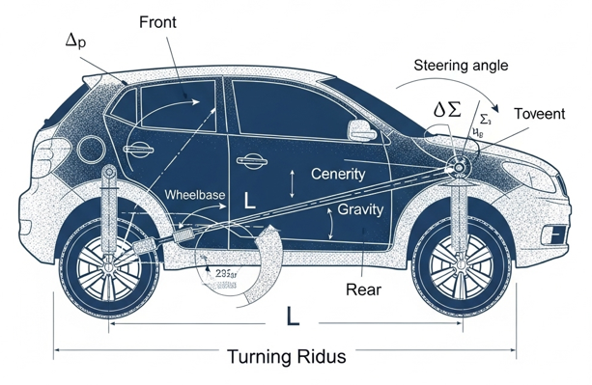
Final Project:
Autonomous Bicycle Parking
STUDENTS PROFESSOR
Catapano Serena Fabio Ruggiero
Varone Emanuela
Autonomous Bicycle Parking- Final discussion
01/22

Slide 2
Why Autonomous Parking?
Technical challenge:
simultaneously coordinate route planning, vehicle control and kinematic constraint management
Primary objective:
develop, implement and critically analyse a complete autonomous parking bicycle
Approach:
comparison of four different controllers to identify the optimal solution
Autonomous Bicycle Parking- Final discussion
02/22

Slide 3
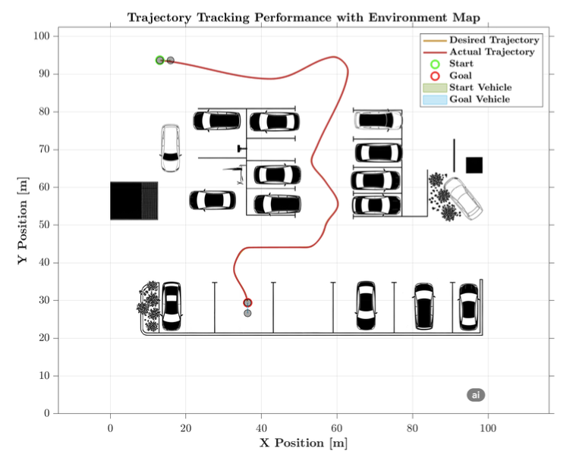
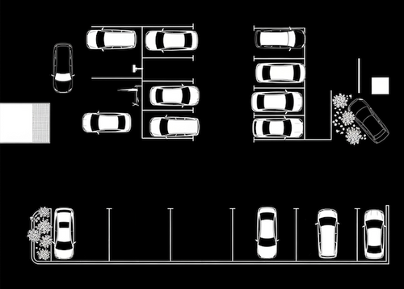
Implementation Workflow
MAP
PRE-PROCESSING
POST-PROCESSING
TRAJECTORY
PATH PLANNING WITH RRT*
Resolution: 0.1m per cell
Inflation radius: 0.5m for safety
Minimum Turning Radius: 4
Connection Distance : 30
Goal Tolerance: [0.5, 0.5, 10]
Minimum Iterations: 2000
Autonomous Bicycle Parking- Final discussion
03/22

Slide 4
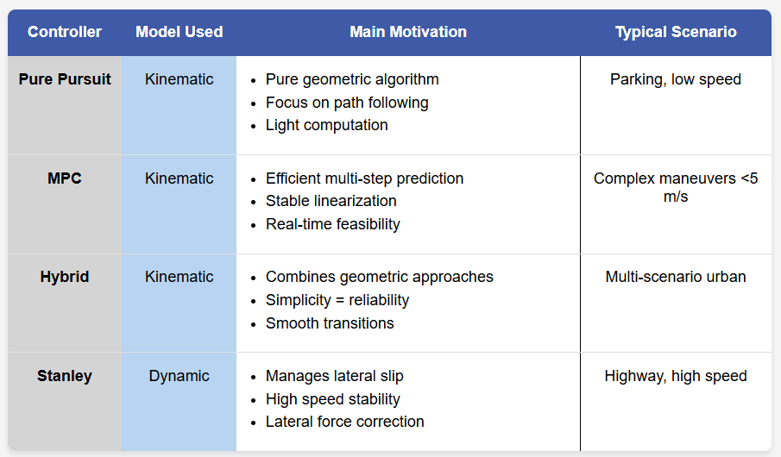
Bicycle Models : Two Modeling Approaches
Kinematic Model
Controllers: Pure Pursuit, MPC, Hybrid
Key Features:
Pure rolling, no slippage
Low speed
Geometric relations of vehicle movement only
Completely ignoring the physical forces involved
Simplicity of implementation
Dynamic Model
Controller: Stanley Controller
Key Features:
Includes lateral forces and tire dynamics
Valid at all speeds
Higher computational complexity
Captures real behaviour (drift, skidding)
Autonomous Bicycle Parking- Final discussion
04/22

Slide 5
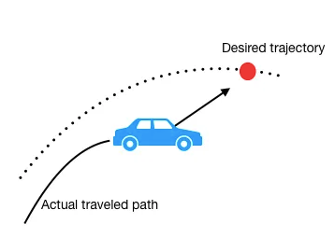
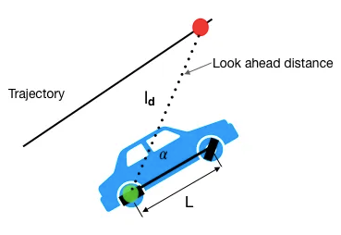
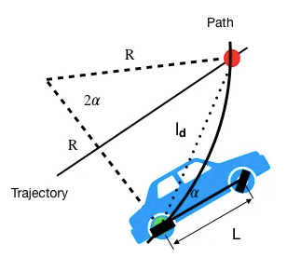
Pure Pursuit Controller
Key Features:
Geometry: triangle between current position, look-ahead point and centre of rotation
Key formula: δ = atan( 2L × sin(α) / ld )
Innovation: Multi-stage adaptive look-ahead distance
Operating phases:
Start (0-5s): the controller applies a conservative strategy to ensure a smooth and safe start
Cruise (>3m from target): the look-ahead distance varies dynamically (2-15m)
Approach (<3m): control accuracy gradually increased (responsiveness improved and faster corrections)
Final accuracy (<0.3m): maximum precision mode (control gain tripled for aggressive corrections)
Autonomous Bicycle Parking- Final discussion
05/22

Slide 6
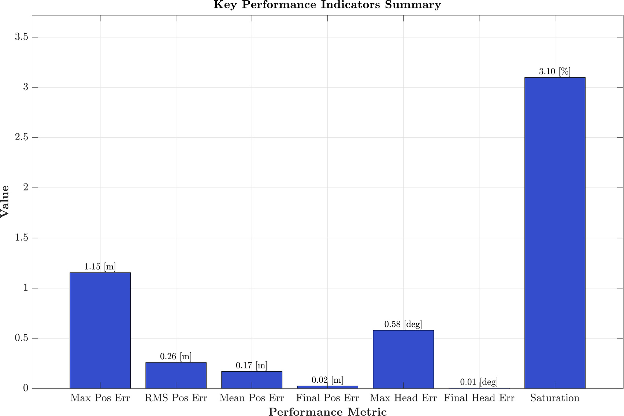
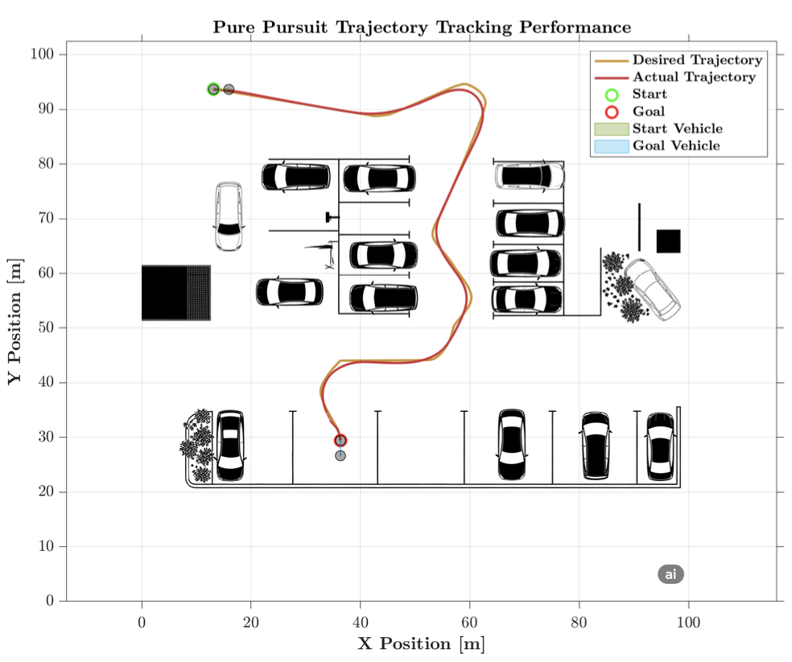
Results:
Good average tracking performance (maximum position error and RMS)
Excellent convergence to the desired parking configuration (minimal final errors)
Frequently demands high control efforts (saturation of 3.10%)
Autonomous Bicycle Parking- Final discussion
06/22

Slide 7
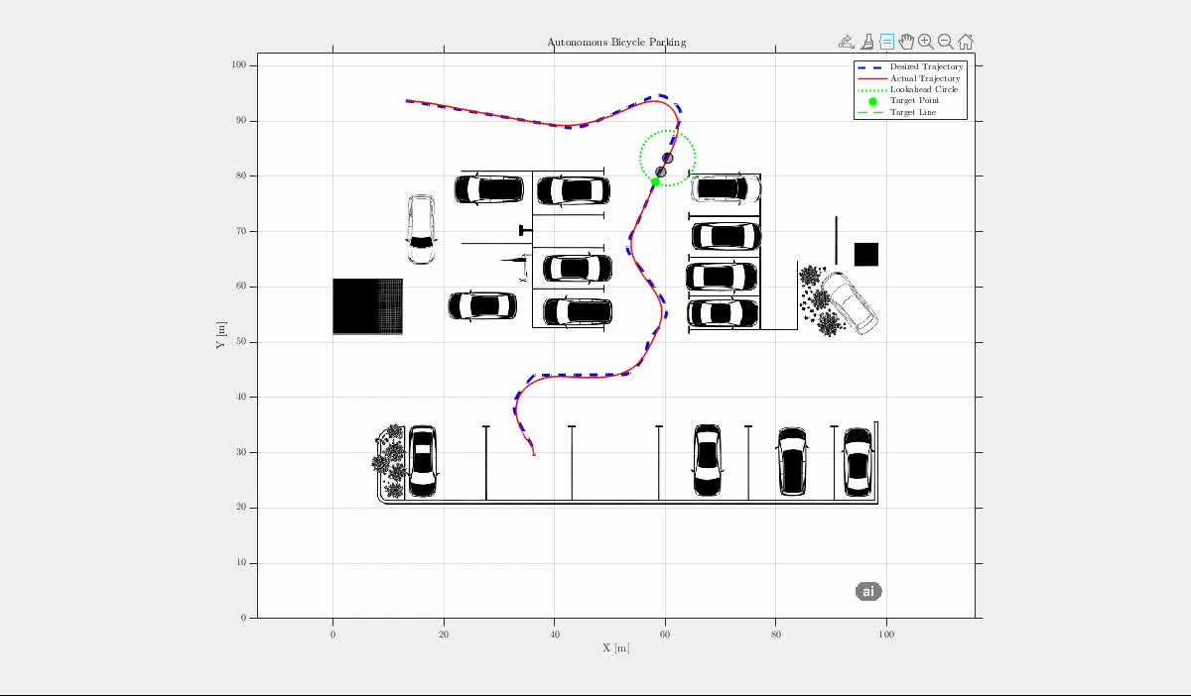
Autonomous Bicycle Parking- Final discussion
07/22

Slide 8
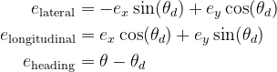
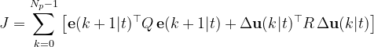
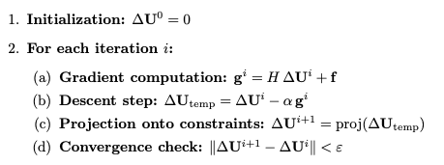
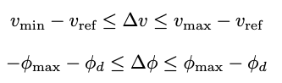
Model Predictive Control
Strategy: "Look Ahead and Optimize"
TRANSFORMATION INTO ERROR COORDINATES
QUADRATIC COST FUNCTION
QUADRATIC PROGRAMMING SOLVER
Linearization
Discretization
Multi-Step Predictive Model
Control Input Constraints
Autonomous Bicycle Parking- Final discussion
08/22

Slide 9
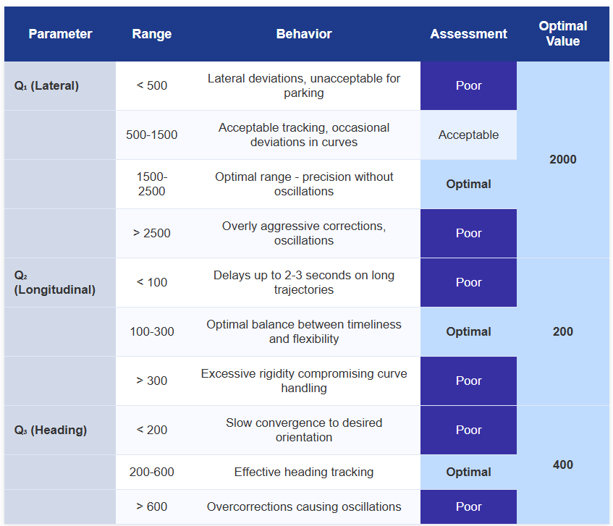
Parameter Tuning
Q Weights Optimization (State Error Penalties)
Q₁/Q₂ = 10 ensures lateral error priority over longitudinal
Q₃/Q₂ = 2 balances heading alignment with timing flexibility
Autonomous Bicycle Parking- Final discussion
09/22

Slide 10
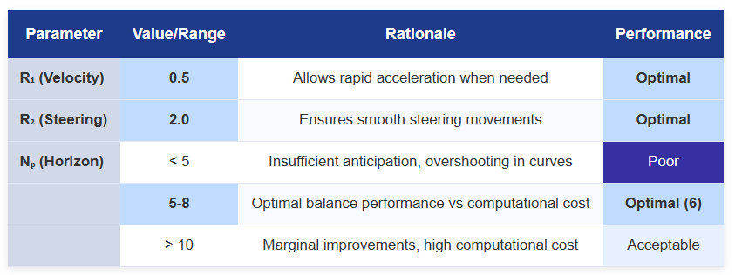
Parameter Tuning
R Weights & Prediction Horizon
Final choice: Nₚ = 6 provides 0.6s anticipation with 8ms computation time
Adaptive Weight Strategy
if approaching_target:
Q_adaptive(1) = Q_nominal(1) * 2.0 // Double lateral importance
Q_adaptive(3) = Q_nominal(3) * 1.5 // Increase heading alignment
R_adaptive(2) = R_nominal(2) * 2.0 // Penalize steering variations
Autonomous Bicycle Parking- Final discussion
10/22

Slide 11
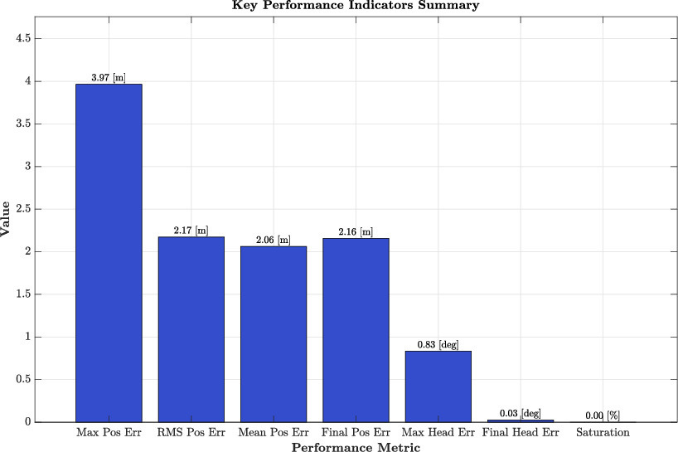
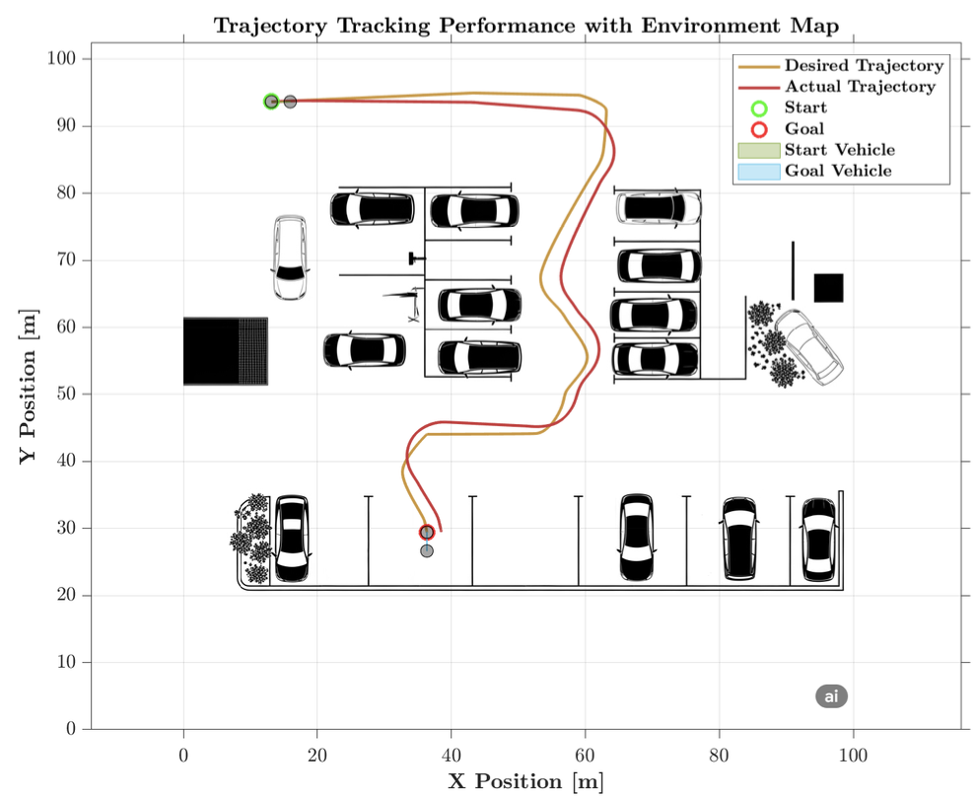
Results:
Mixed performance profile
Never reaches actuator limits and maintains smooth control throughout the maneuver (saturation at 0.00%)
Fails to converge to the desired parking position accurately (final position error)
Orientation control is more effectively managed than position tracking
Autonomous Bicycle Parking- Final discussion
11/22

Slide 12
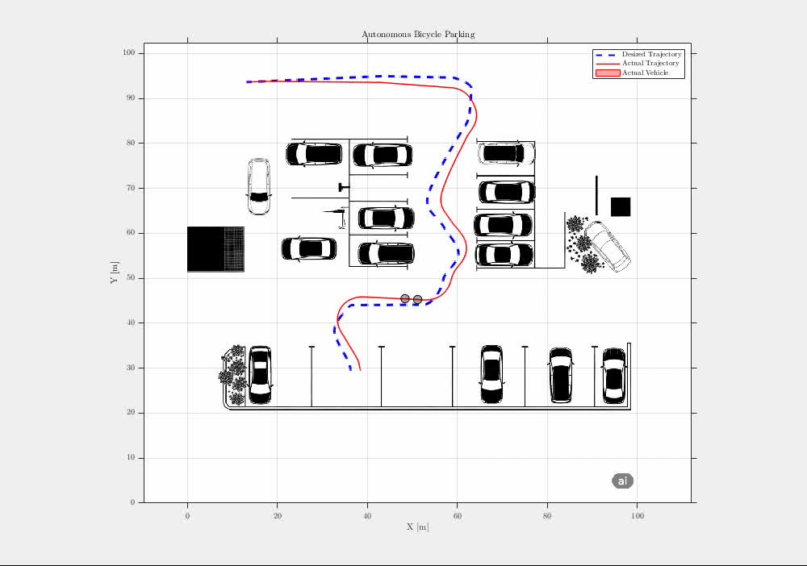
Autonomous Bicycle Parking- Final discussion
12/22

Slide 13
Hybrid Multi-Mode Controller
Modular Architecture
Integrated components:
ERROR PREPROCESSING MODULE
Feedforward-feedback control for longitudinal tracking
Stanley-type lateral control for transverse error correction
Heading control for orientation correction
Supervisory logic for managing the different operating phases
OPERATIONAL DECISION MODULE
v_cmd = v_base × lateral_factor × heading_factor (v_base = v_ref + k₁·e_long)
φ_lateral = atan2(k_stanley·e_lat, max(0.5, |v_cmd|))
φ_cmd = φ_feedforward + φ_lateral + φ_heading
φ_heading = -k₂·e_θ
φ_feedforward = atan(L·θ̇d/v_cmd)
APPROACHING TARGET
PARKING COMPLETED
Autonomous Bicycle Parking- Final discussion
13/22

Slide 14
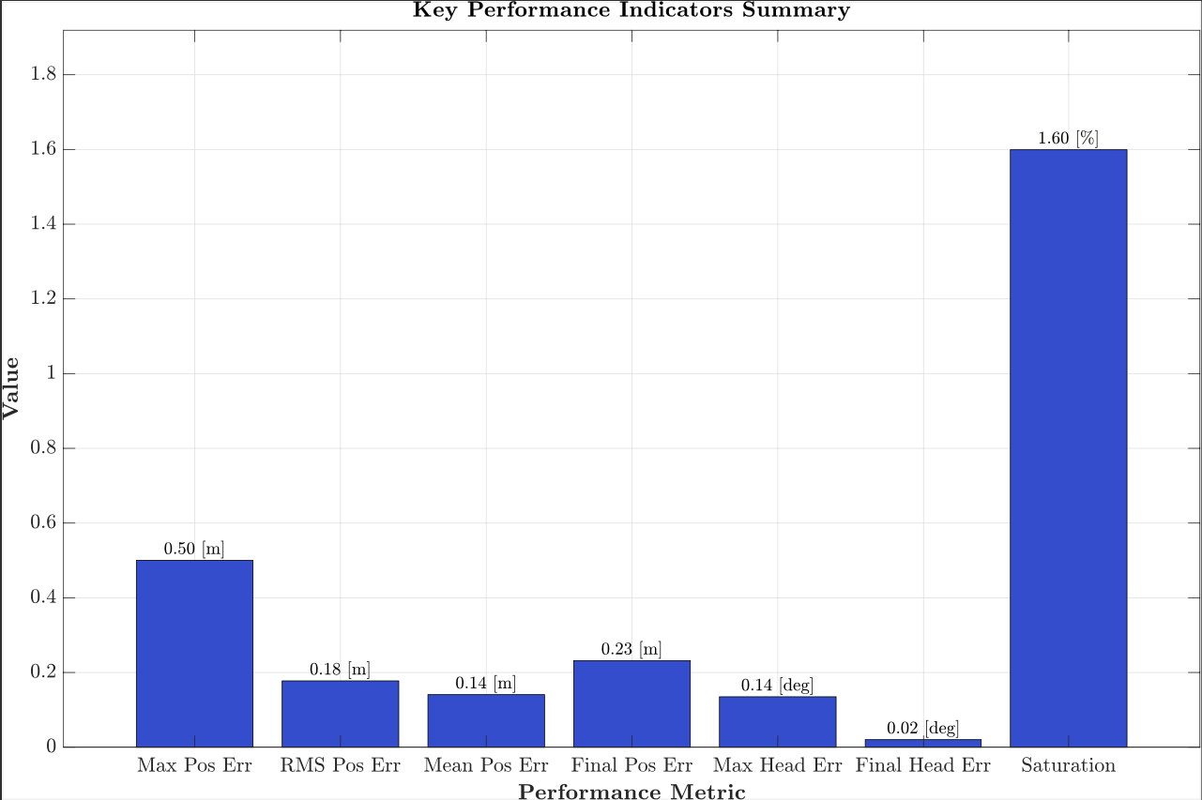
Results:
Excels at maintaining close adherence to the reference trajectory
Not only tracks the position accurately, but also ensures proper orientation alignment
Occasionally demands control inputs at or near the actuator limits (1.60% saturation)
Autonomous Bicycle Parking- Final discussion
14/22

Slide 15
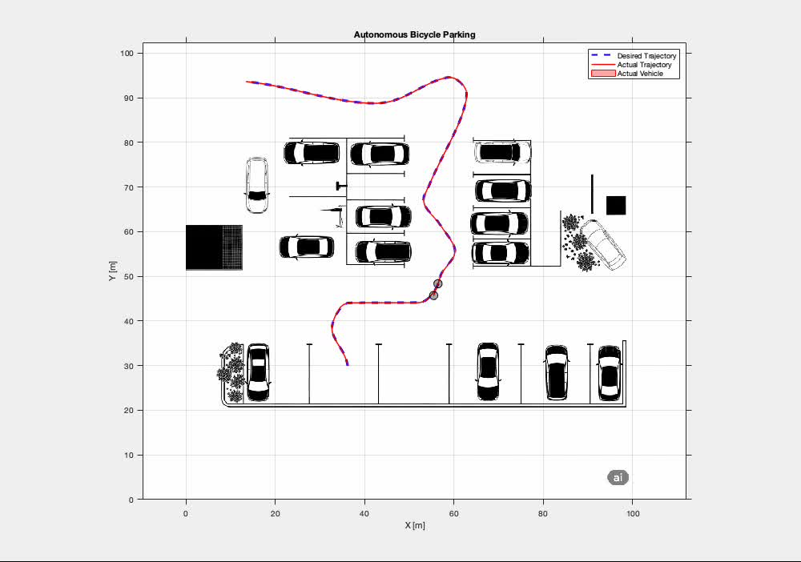
Autonomous Bicycle Parking- Final discussion
15/22

Slide 16
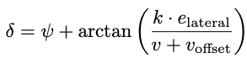
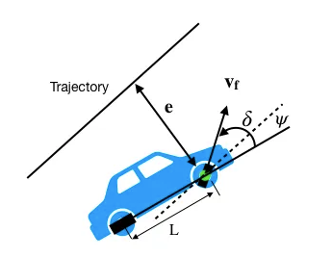
Stanley Controller
STANLEY LONGITUDINAL CONTROLLER
The algorithm combines two intuitive actions: first, orient the vehicle towards the target point to correct the orientation
error, then add an additional correction proportional to the lateral distance from the target point to ensure stable
convergence. The Stanley control law can be expressed mathematically as:
HANDLES MOVEMENT ALONG THE DIRECTION
OF VEHICLE TRAVE
STANLEY LATERAL CONTROLLER
HANDLES MOVEMENT PERPENDICULAR
TO THE DIRECTION OF TRAVEL
Autonomous Bicycle Parking- Final discussion
16/22

Slide 17
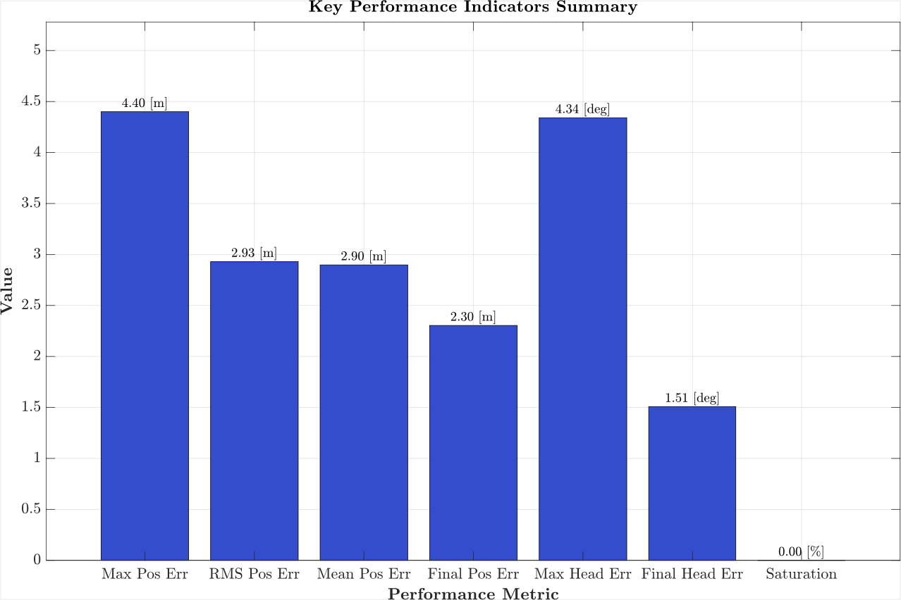
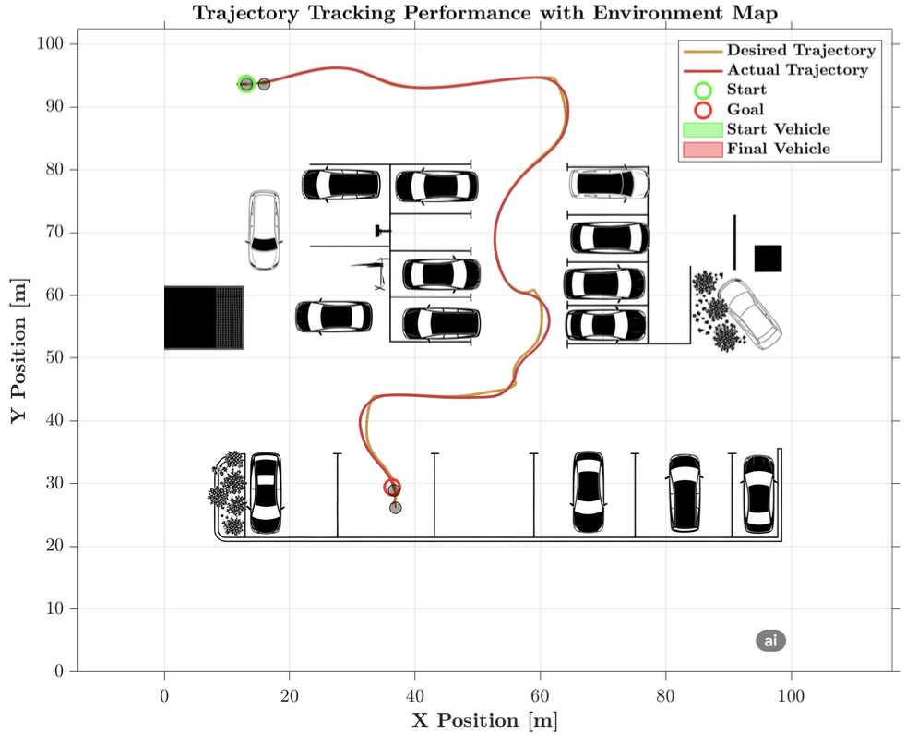
Results:
Achieves perfect control feasibility with 0.00% saturation
Operation strategy: it allows larger transient errors but maintains smooth, feasible control throughout the maneuver. The front-wheel position feedback mechanism characteristic of Stanley control appears to provide natural damping that prevents excessive control demands.
Autonomous Bicycle Parking- Final discussion
17/22

Slide 18
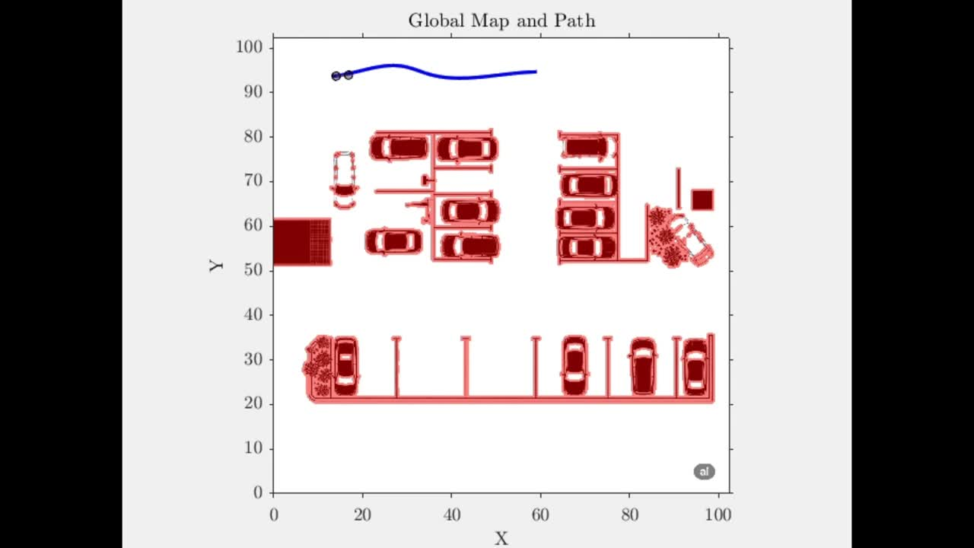
Autonomous Bicycle Parking- Final discussion
18/22

Slide 19
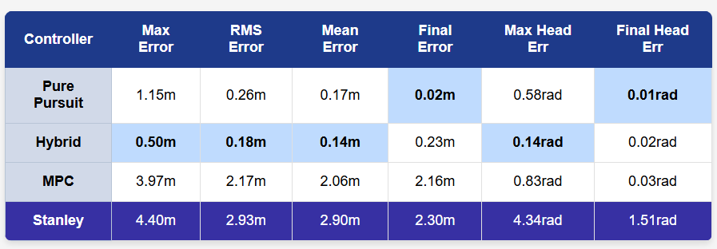
Comparative analysis - TRACKING
Hybrid dominates overall tracking performance
Pure Pursuit excels in final convergence precision
MPC sacrifices accuracy for control smoothness
Stanley unsuitable for tight nonholonomic constraints
Data clearly demonstrates the hybrid approach superiority in balancing tracking precision with final convergence accuracy
Autonomous Bicycle Parking- Final discussion
19/22

Slide 20
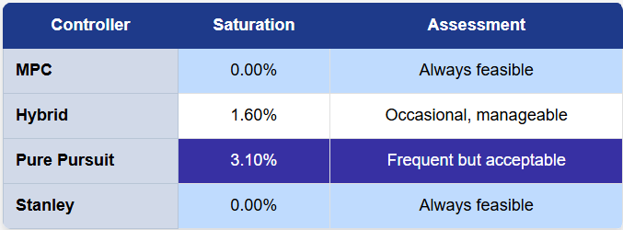
Comparative analysis - CONTROL
Saturation vs Control: MPC achieves zero saturation with optimal feasibility
Efficiency vs Aggressiveness: Pure Pursuit shows moderate saturation but remains acceptable
Balance vs Performance: Hybrid maintains low saturation while managing complexity
Actuator saturation is a critical indicator of practical feasibility. Both MPC and Stanley achieve zero saturation with optimal control demands, while Hybrid maintains excellent performance with minimal saturation at 1.60%. Pure Pursuit shows higher saturation at 3.10% but remains within acceptable operational limits.
Autonomous Bicycle Parking- Final discussion
20/22

Slide 21
FUTURE DEVELOPMENTS
Experimental validation on real vehicle
Robustness to uncertainties and disturbances
Computational optimisation for real-time
Extension to parallel and oblique car parks
Autonomous Bicycle Parking- Final discussion
21/22

Slide 22
THANKS FOR THE ATTENTION
Autonomous Bicycle Parking- Final discussion
22/22

